Slide 1
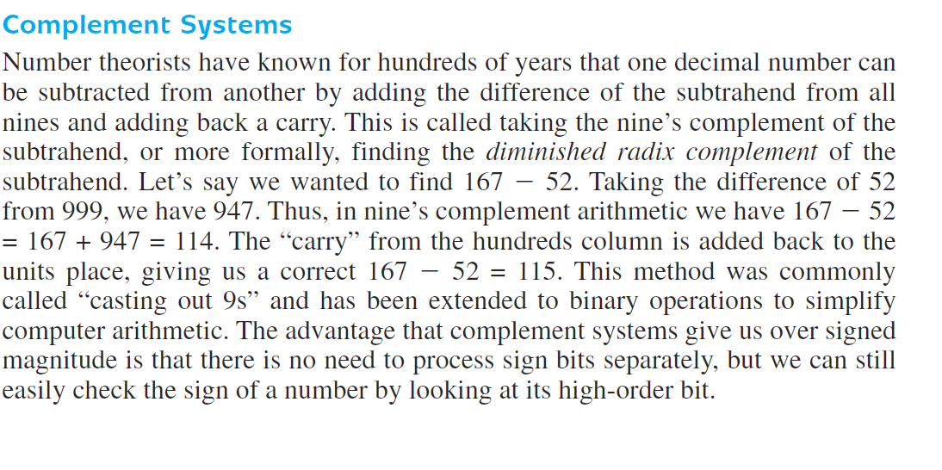

Slide 2
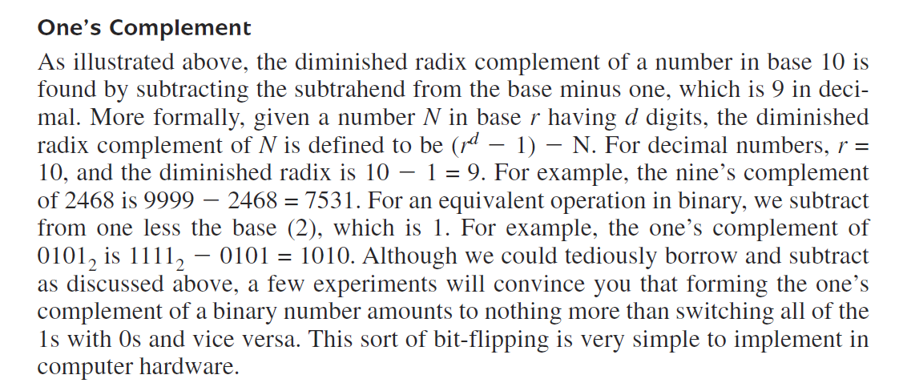

Slide 3
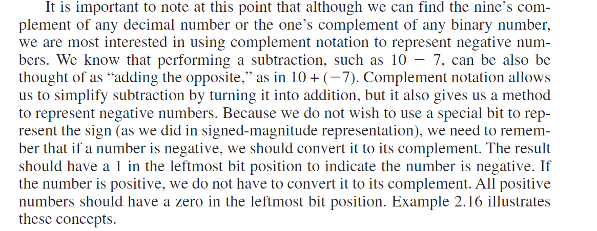

Slide 4
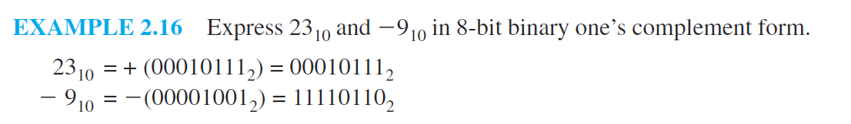
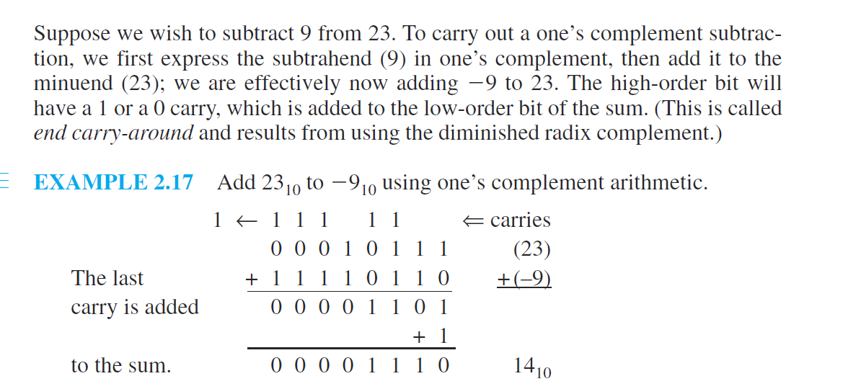

Slide 5
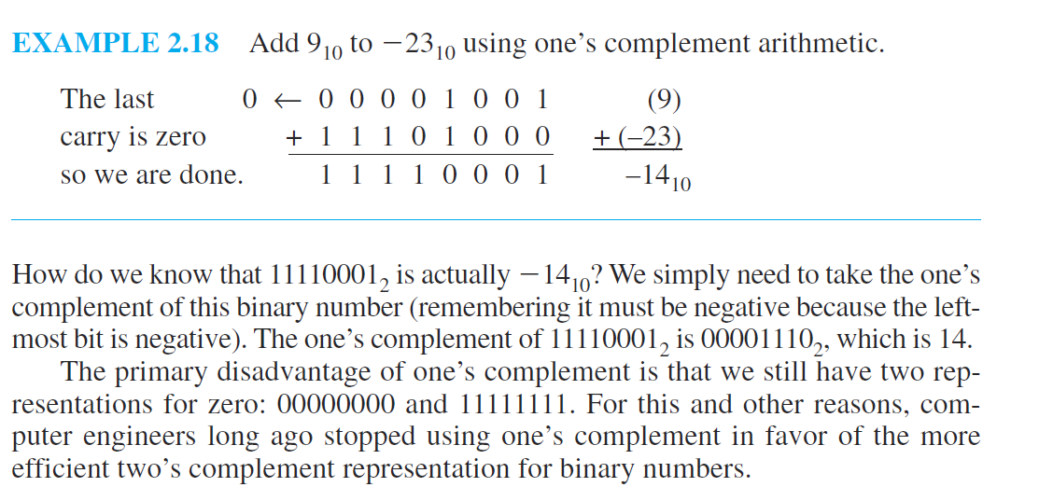

Slide 7
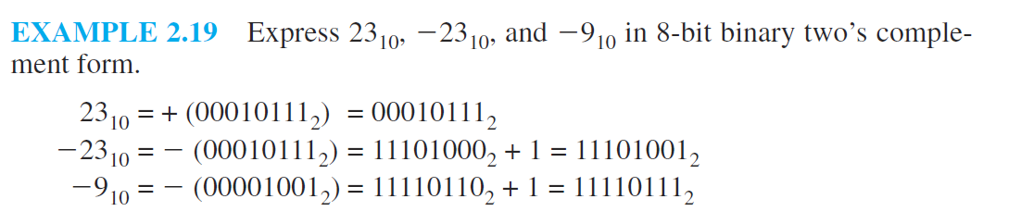

Slide 8
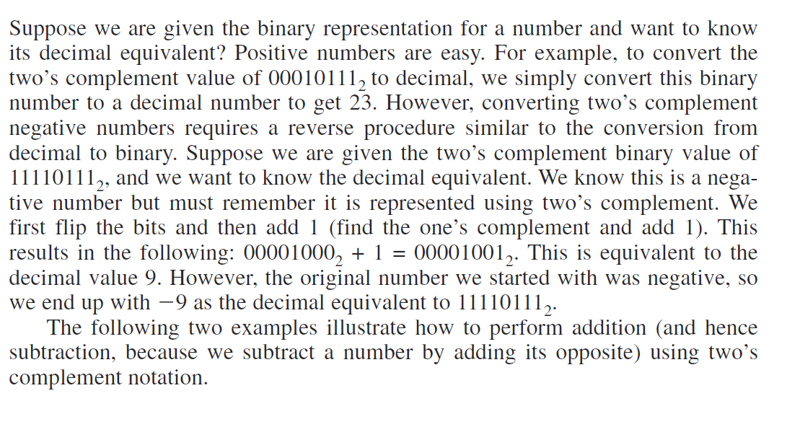

Slide 9
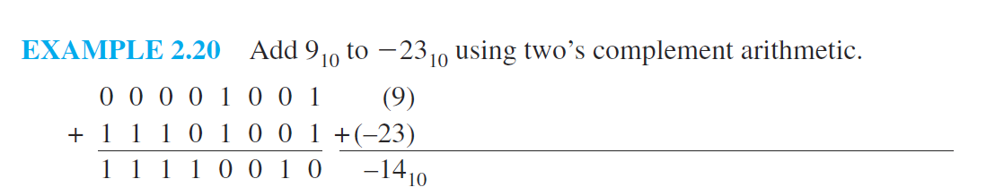

Slide 10
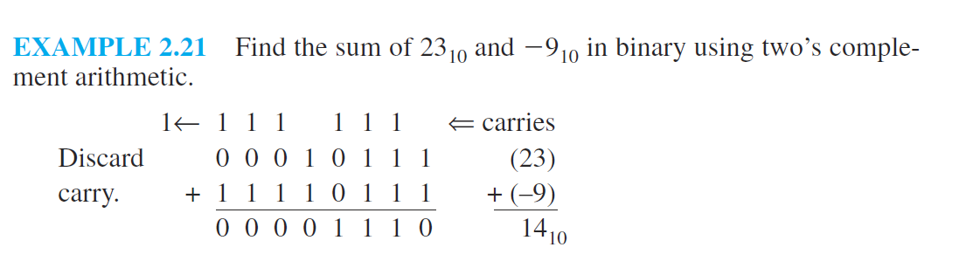

Slide 11
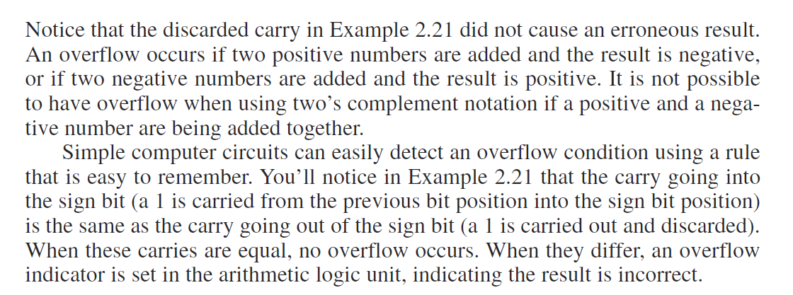

Slide 12
A Simple Rule for Detecting an Overflow Condition: If the carry into
the sign bit equals the carry out of the bit, no overflow has occurred. If
the carry into the sign bit is different from the carry out of the sign bit,
overflow (and thus an error) has occurred.

Slide 13
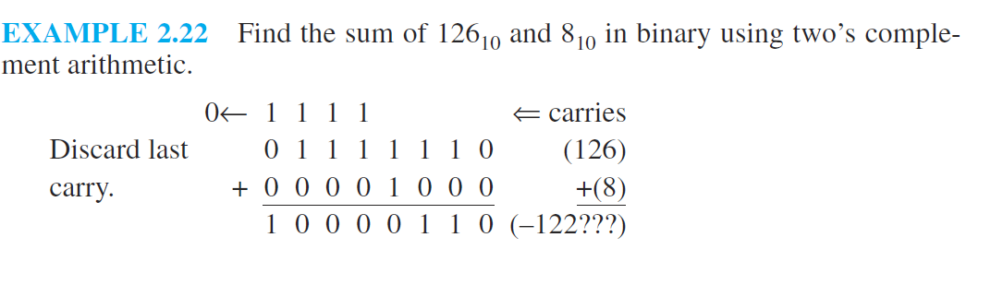

Slide 14
A Simple Model
In digital computers, floating-point numbers consist of three parts: a sign bit, an
exponent part (representing the exponent on a power of 2), and a fractional part
called a significand (which is a fancy word for a mantissa). The number of bits
used for the exponent and significand depends on whether we would like to optimize
for range (more bits in the exponent) or precision (more bits in the significand).
For the remainder of this section, we will use a 14-bit model with a 5-bit
exponent, an 8-bit significand, and a sign bit (see Figure 2.2)

Slide 15
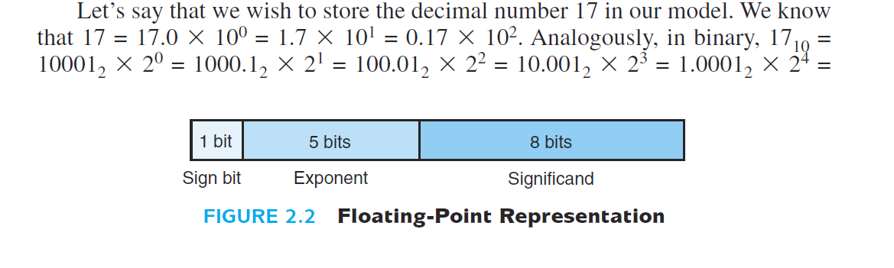
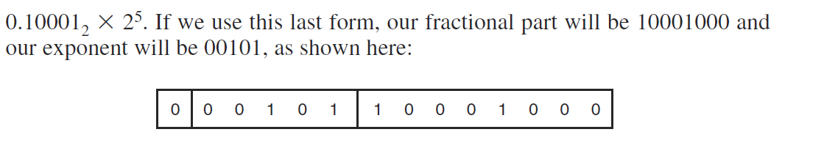

Slide 16
